Slide 1
“LIVING THE LAB LIFE” A BLOG FOR ASCLS REGION V
EMMA MILLER
KELLEY WEBER
REBECCA RAM-AYBAR

Slide 2
BACKGROUND ON LEADERSHIP ACADEMY
WHAT IS IT?
Leadership Academy includes:
Group project to be completed in one year (and presented at the next Tri-State meeting) that will further the goals of ASCLS at the state, regional, or national level
Not a project directed to the awareness of the profession to the public or to promote the profession to students
HOW TO APPLY:
Anyone can apply!
Due Date: June 1st
Application on Region V website

Slide 3
BACKGROUND ON LEADERSHIP ACADEMY
DUTIES
Attend
REGION V TRI-STATE FALL SYMPOSIUM for the current year and the next year
May Retreat
Monthly Conference calls (about one hour long)
Alternate leading, making agendas for conference call
Work on your chosen project throughout the year
Read and report on one leadership based book and present to group
Have fun! ☺

Slide 4
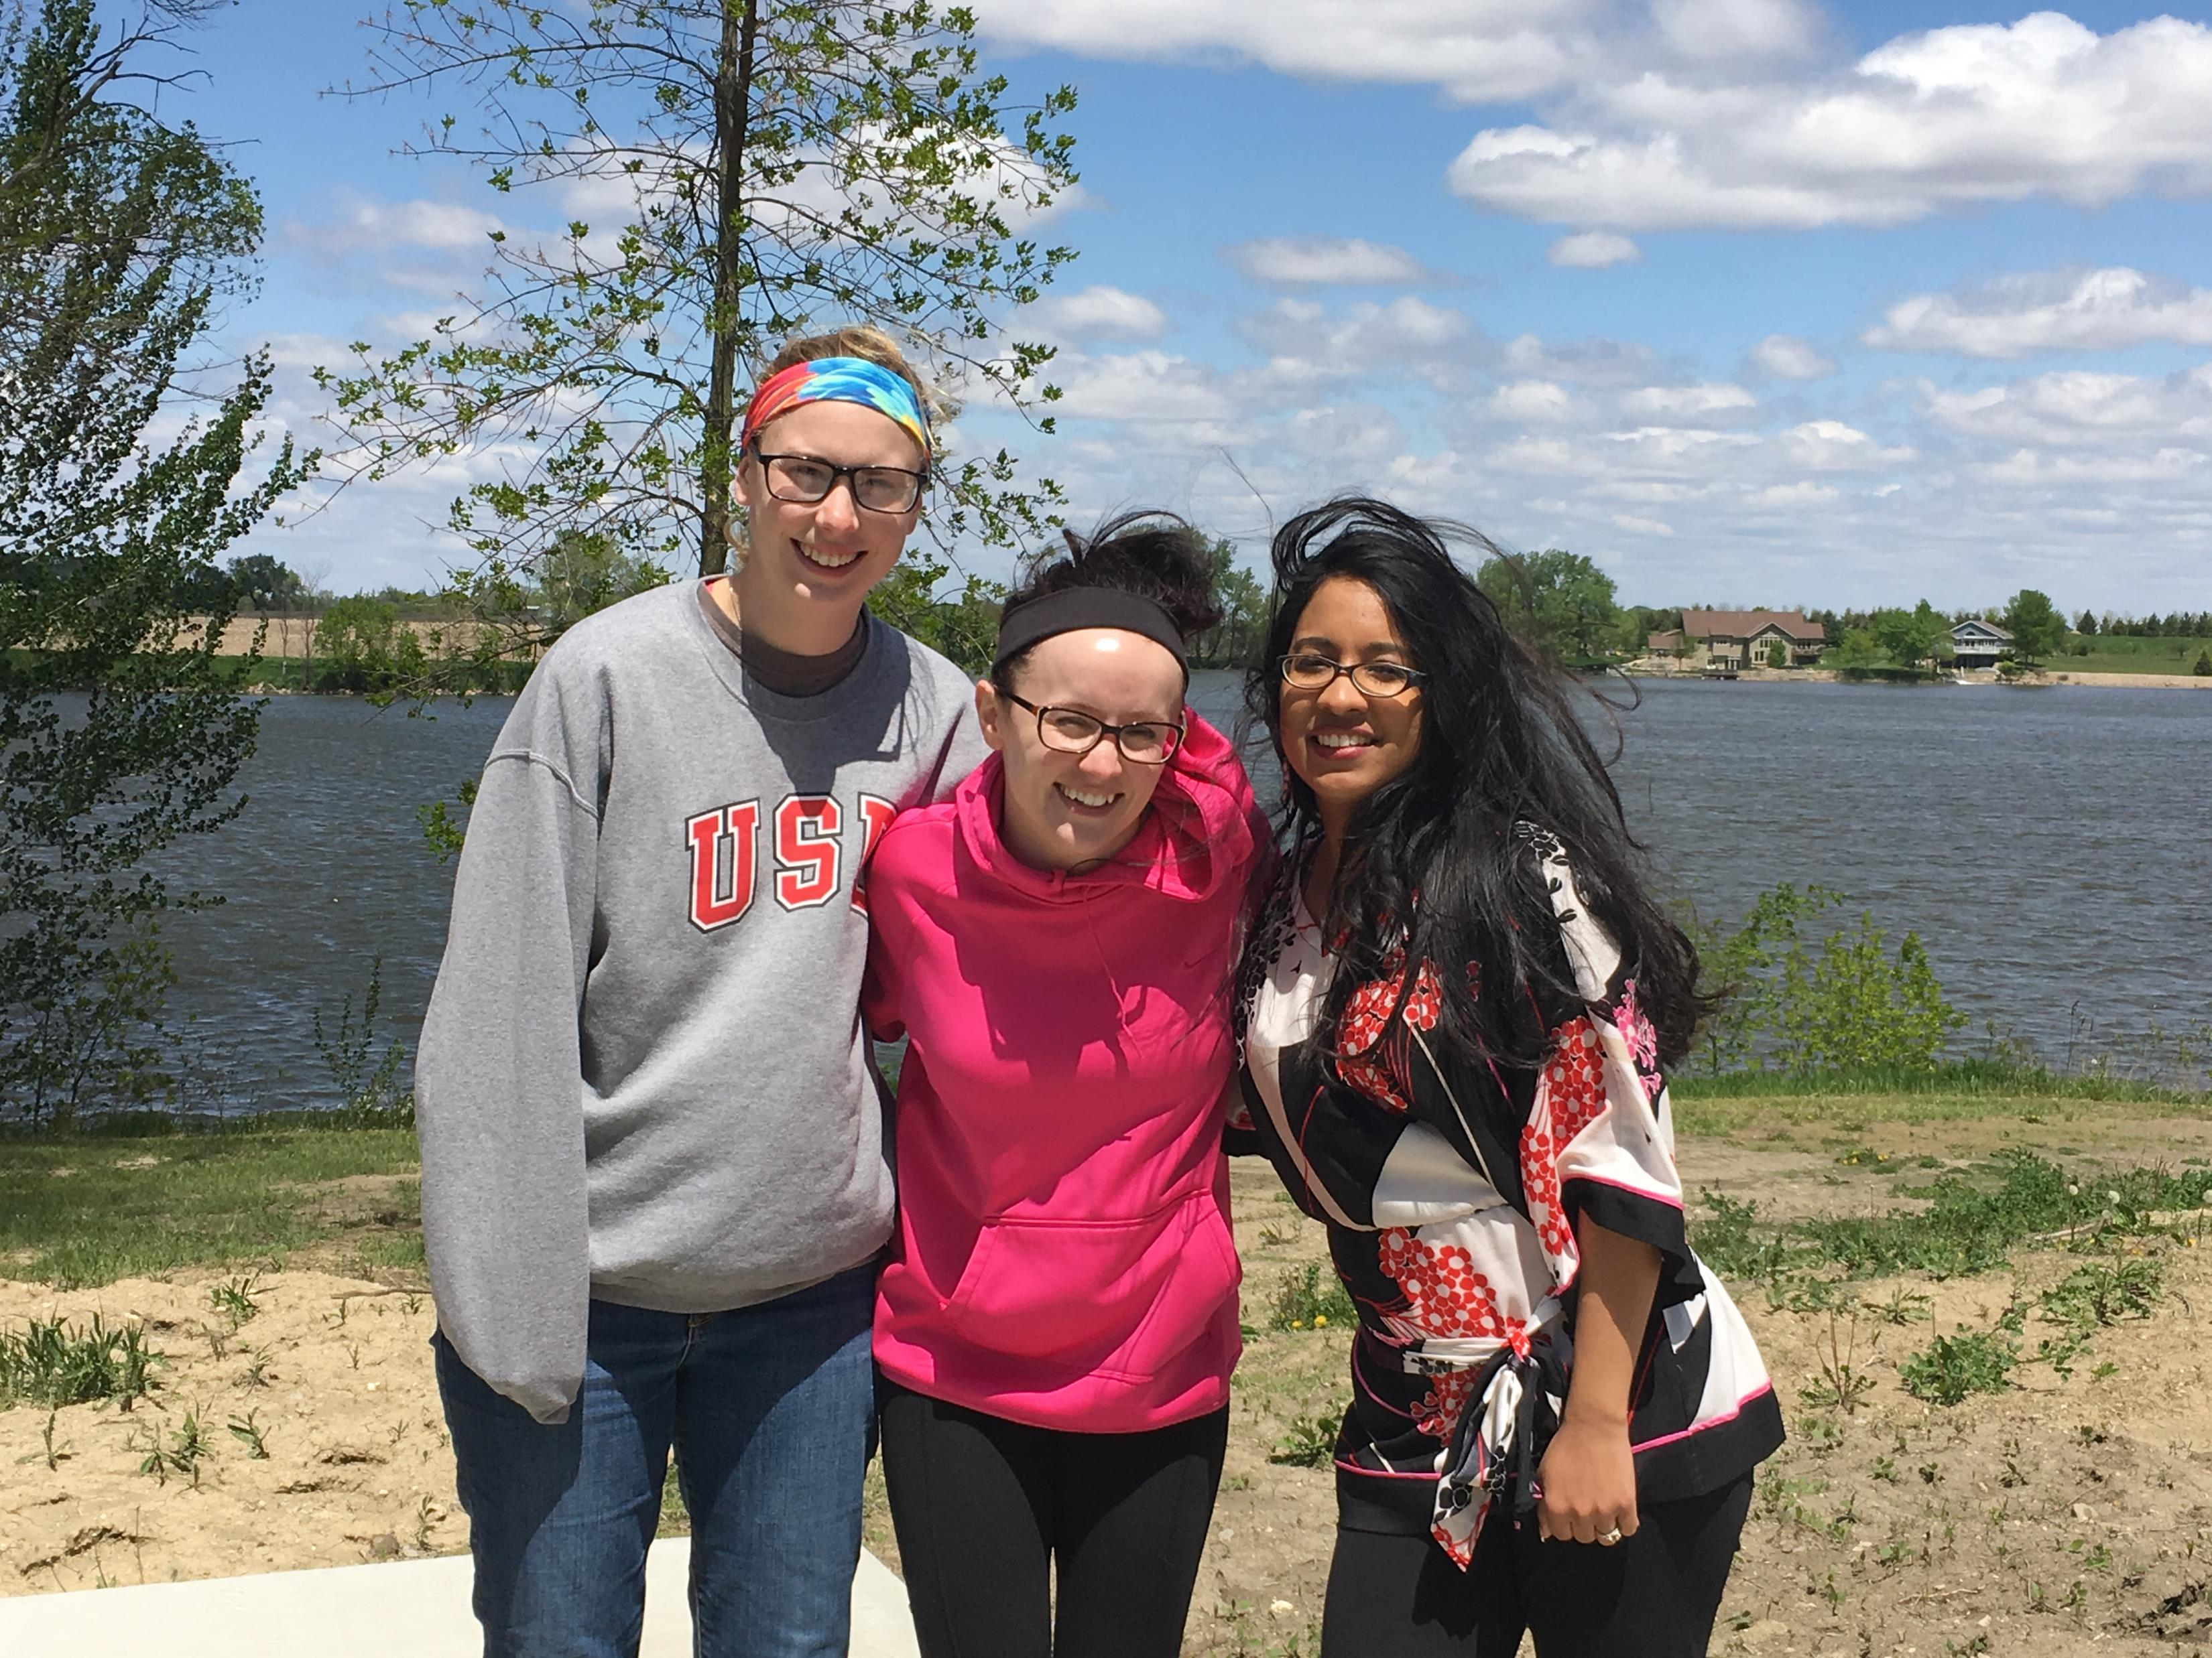
OUR Leadership ACADEMY STORY
2015-2016

Slide 5
Our mission
To create a product by ASCLS, for ASCLS, which will benefit the ASCLS membership and the organization as a whole

Slide 6
OUR ORIGINAL IDEAS…
Resource materials for recruiting college students
Blog
Lab week stuff
Resources for ASCLS leadership
Discount rates for FYP
Mentorship experience
Brochures
Career fair
Professional development
Elevator speeches
Convert student members to FYP
Poster presentations

Slide 7
One-stop shop for laboratory professionals

Slide 8
OUR Vision
To promote the laboratory profession and the ASCLS organization by creating a blog that will not only contain articles about issues that affect clinical laboratory scientists, but also several small projects that members can take advantage of. This blog will also be created so as future leadership academy individuals can take advantage and utilize this blog for their purposes. The vision is to use the blog as a social media outlet to reach members and non-members so as to increase retention rates of current members and to entice new members to join.
Notes:
To paraphrase: We wanted to create … easy to maintain, easy to reach large number of people (non/members), host to a wide variety of topics

Slide 9
The Blog
“Living the Lab Life”

Slide 10
Why create a blog?
Engage a large audience of potential and existing members
Authors can be changed at any time
Flexible platform
Interactive
Links to other webpages
Informal
Notes:
Part of the public domain
Not ideal to have turnover, but can be useful to help incorporate new ideas.
Individual blog posts can be tied into facebook and twitter
Comments are posted in real-time, although authors can review and delete and comments deemed inappropriate
ASCLS nat’l and state websites, other lab/medical/research sites
Less time committed, engage more people

Slide 11
http://www.regionvascls.online/living-the-lab-life

Slide 12
Region V Homepage→ “Living the Lab Life”

Slide 13
Notes:
Demonstrate how to navigate to the blog from the main page

Slide 14
Blog Format
Blog posts organized with newest appearing at the top
Locked side bar

Slide 15
Sidebar
Survey
Archives
Search Function
Author Biographies
Categories
Contact Form
Social Media Links
RSS Feed

Slide 16
Blog Post Features
Text
Video
Sound Clips
Slideshows
External Documents
Links to other websites
Notes:
Show the types of information that can be posted,

Slide 27
Weebly Features
Notes:
We can assess trends to see what content

Slide 30
POTENTIAL Discussion Topics

Slide 31
Potential Topics…
Workforce Shortage
Licensure
Continuing Education
Board of Certification
Graduate Programs
Lab Week Activities
Mentorship
Emerging Technologies
Infection Prevention
Laboratory Management
Regulatory Affairs
ANYTHING LABORATORY SCIENCE, HEALTHCARE, OR PROFESSIONAL DEVELOPMENT RELATED

Slide 32
ASCLS Activities
Upcoming events
Continuing education
Government affairs
Leadership programs
Volunteer opportunities
Fundraising efforts
Notes:
The blog can be used to promote all ASCLS activities

Slide 33
Book Reviews

Slide 34
Each leadership academy participant picked a book from the Leadership Academy suggested book list and presented a review of that book.
http://www.regionvascls.online/living-the-lab-life/looking-for-a-good-read-this-summer
Emma – “Eat That Frog” by Brian Tracy
Kelley- “The 7 Habits of Highly Effective People” by Steven Covey
Rebecca- “Daring Greatly: How the Courage to be vulnerable transforms the way we live, love, parent and lead” by Brene Brown.

Slide 35
Leadership Academy mini-projects

Slide 36
Mini Projects
Each member of the leadership academy is responsible for a project that will promote ASCLS
That project is promoted through the blog
The projects:
Emma → Material for promoting the profession to elementary age students Grades: 3-6
Kelley → Brochures to promote ASCLS
Rebecca → A poster competition

Slide 37
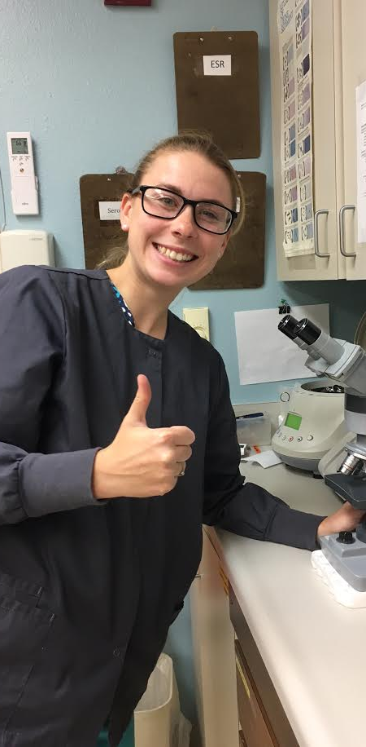
Emma- Educational Material for elementary grade children
Resource/Activity Kit to promote the medical laboratory science profession for lab professionals to teach to elementary age children

Slide 38
Elementary students
Ella → age 9

Slide 39
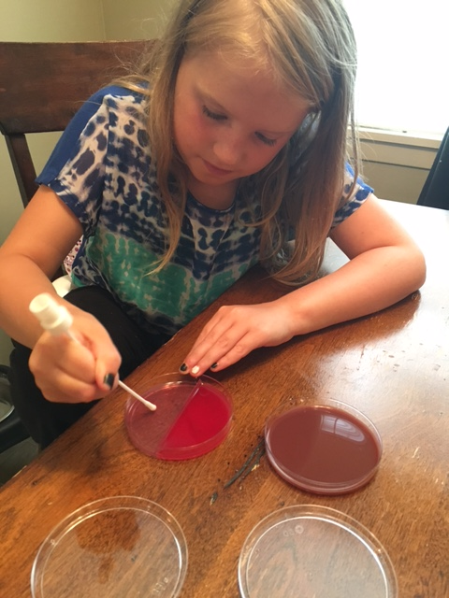
Emma- Educational Material for elementary grade children
Process:
Develop easy-to-use links/activities to assist lab professionals discuss their career with kids or family
Search online resources to find out different activities appropriate for various child age ranges
Post information to blog via posts or links to assist readers with educational materials

Slide 40
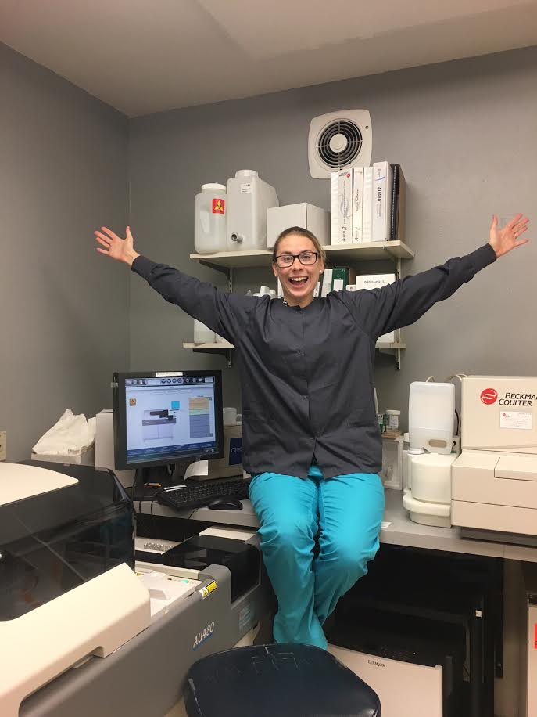
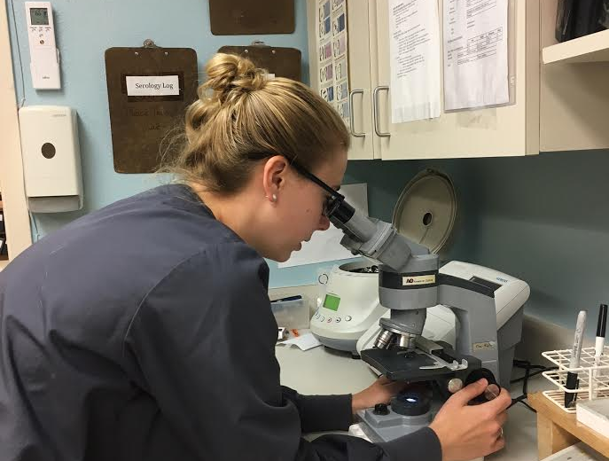
What does aunt emma do?
Medical Laboratory Scientist
I run tests to help doctors diagnose/figure out what is making a person feel sick
I draw blood from a patients arm or finger
I make sure all the equipment/machines in my lab work and run my tests accurately
I use my eyes, hands, sometimes nose (but never my mouth), to help me get answers to doctor’s questions
I answer nurses and doctors questions
I work in a hospital laboratory

Slide 41
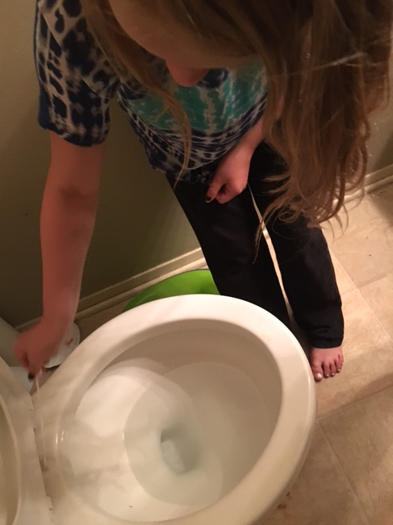
Germs/bacteria
They’re everywhere…on our skin, on the table, on the toilet…etc.
Too tiny to see with our eyes, but not with a microscope or plating them on agar
Agar is like a nutrient jello that bacteria like to live on and eat; this makes them multiple and grow big so we can see them as colonies on agar
Normal flora vs. pathogens
Some germs/bacteria are good and keep us healthy by fighting off bad bacteria
Some germs/bacteria are not good for us and make us sick

Slide 42
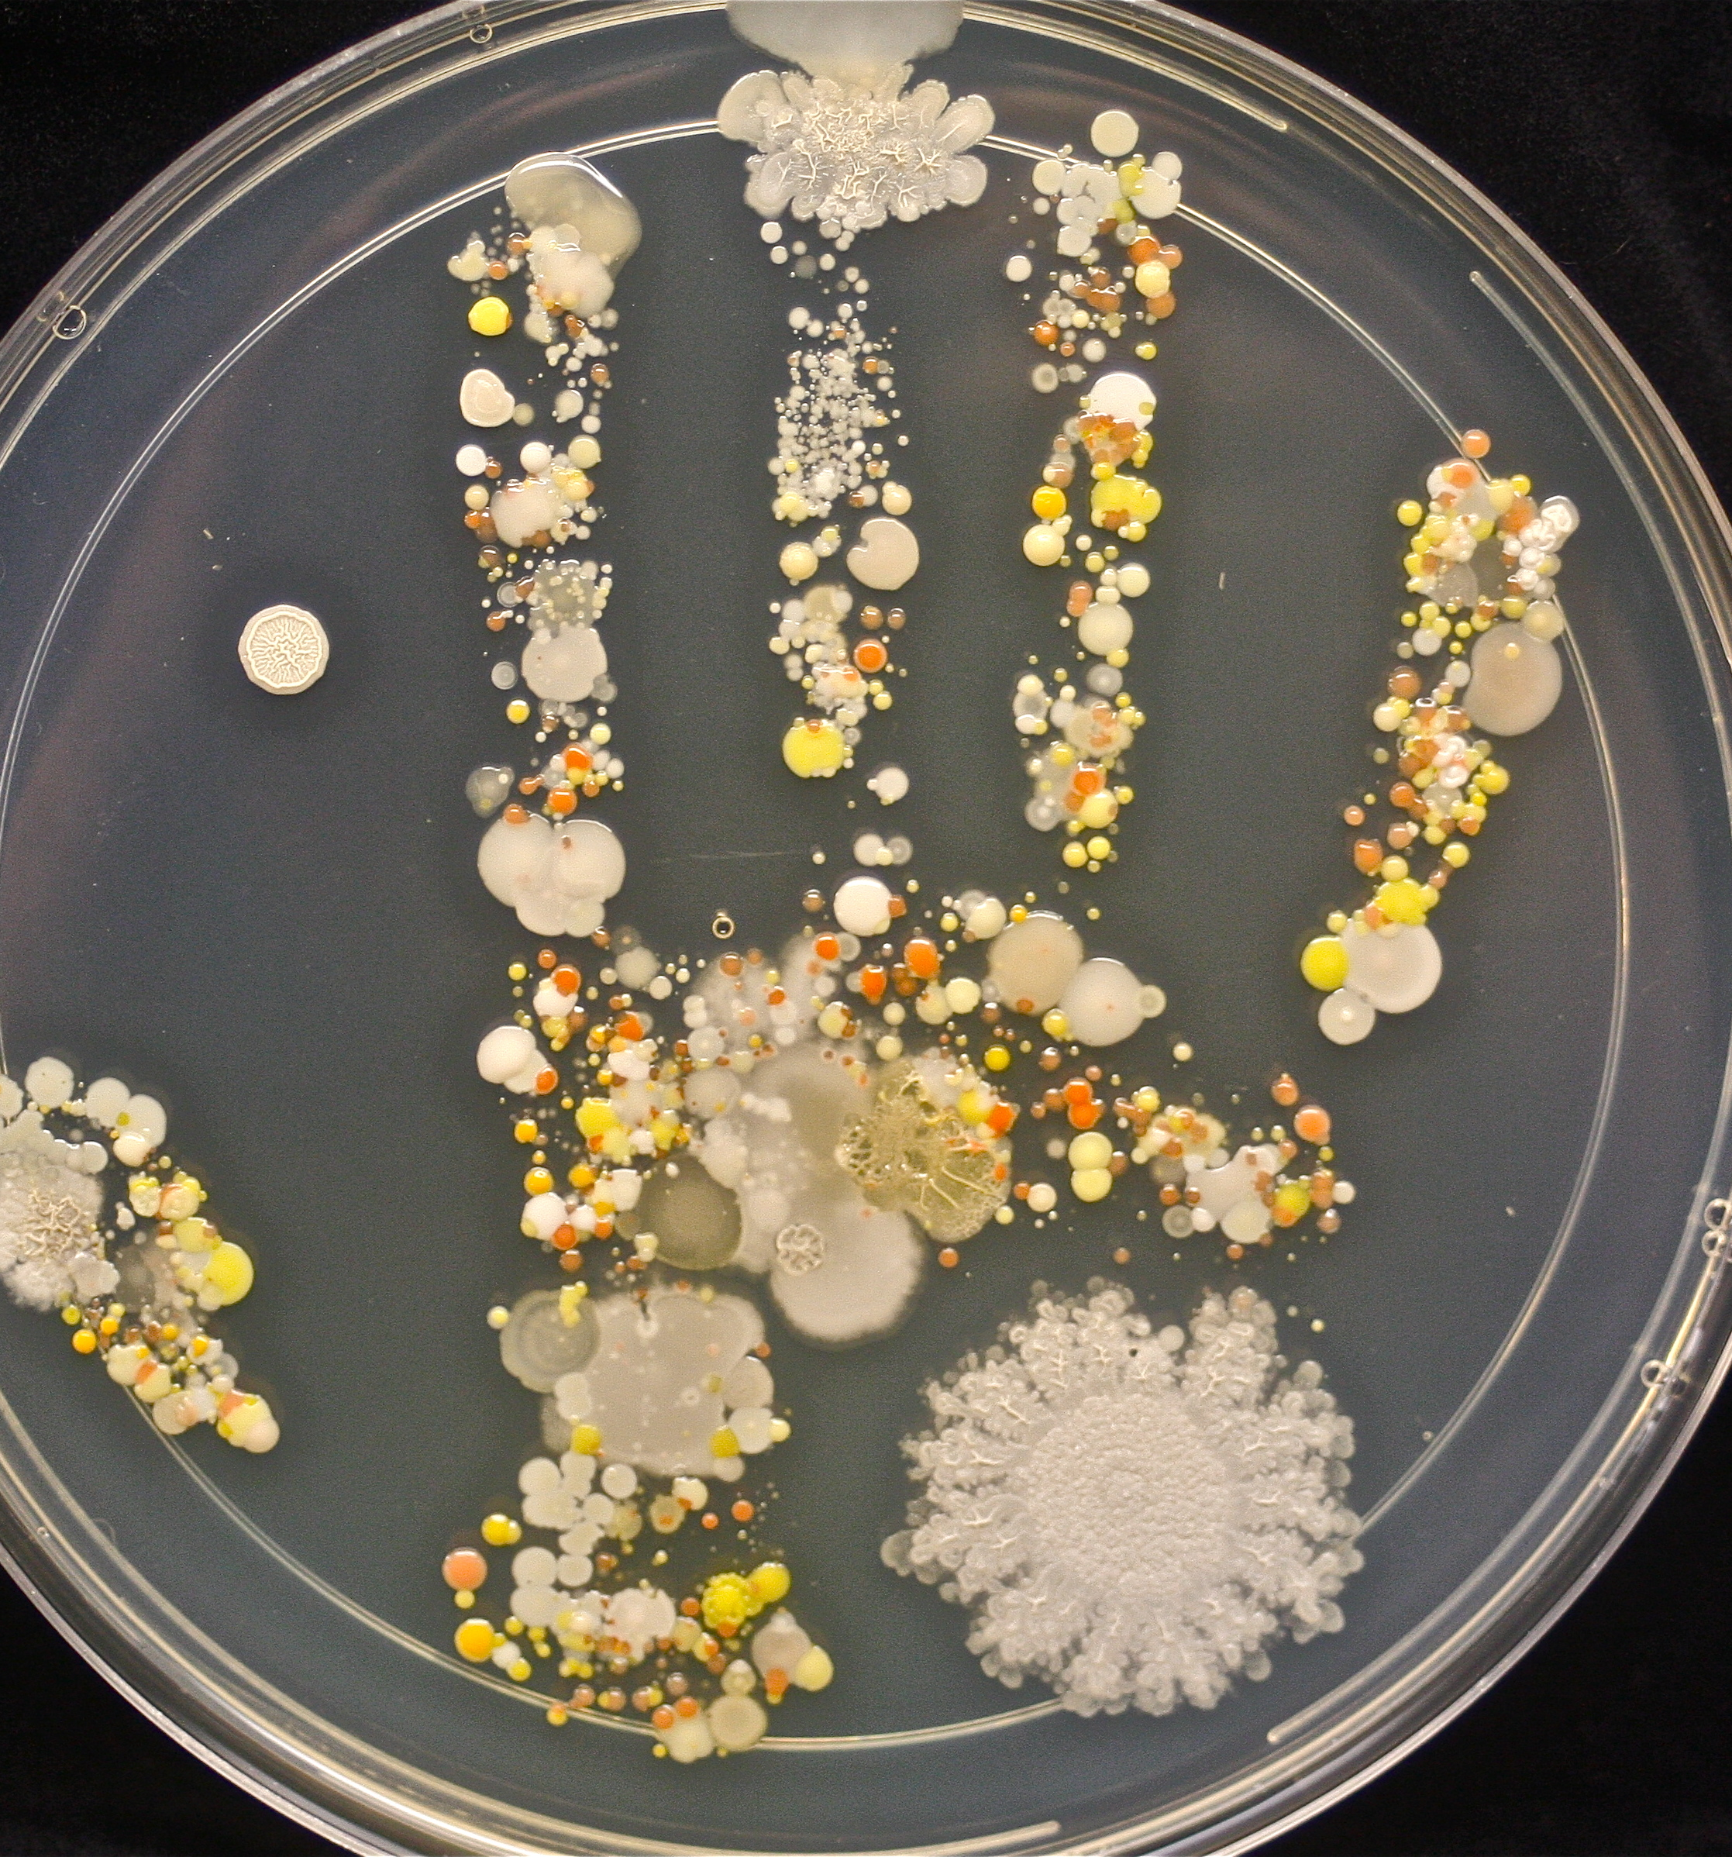
bacteria

Slide 43
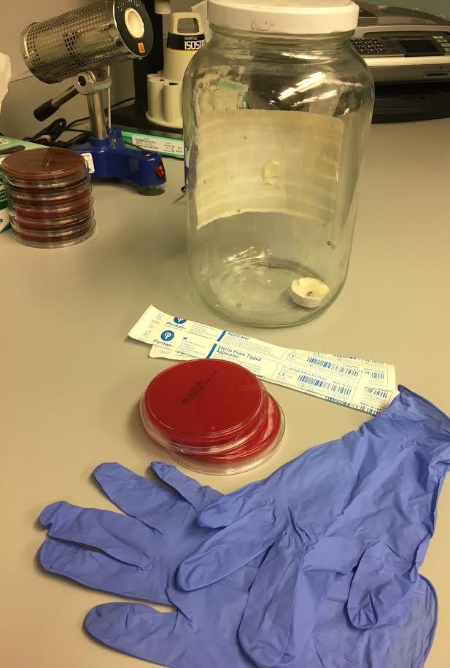
Materials
Agar (expired from work or see homemade recipe here….)
https://www.madaboutscience.com.au/store/index.php?main_page=page&id=43
Pickle Jar
Tea Candle
Swab
Gloves
Imagination!

Slide 44
Streaking an agar
Slide swab back and forth
Swirl the swab so all the bacteria get on the agar
Lab professionals, that work in the microbiology department, in the next couple of days will look at what grows and be able to tell the doctor what specific bacteria is making the patient sick

Slide 45
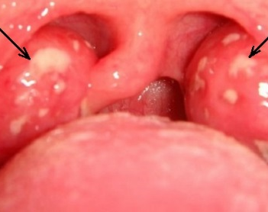
strep
How we test that really, really, sore throat
Swab the back of the patient’s mouth near the tonsils
Mix reagents (liquids that help the test work) and insert swab
Set a timer, let it soak, and watch it work its magic

Slide 46
Strep kit

Slide 47
handwashing
Helps us stay healthy by washing off any bad bacteria
Need to use soap to kill the bad bacteria and then wash them away down the drain
Even though we wear gloves in the lab, we still need to wash our hands
Don’t spread them! Wash your hands every time they are dirty from playing or using the bathroom

Slide 48
Got younger kids at home?
Coloring book pages!
Insert coloring pages from google that are lab-based
Search: google -- coloring pages about laboratory
http://kurld.com/images/chemistry-coloring-pages/chemistry-coloring-pages-20.png
http://kurld.com/images/science-lab-coloring-pages/science-lab-coloring-pages-3.jpg
https://www.coloringtone.com/wp-content/uploads/2016/05/free-science-coloring-pages.jpg?8a837d
http://mycoloring-pages.com/images/Cartoon/Dexter-Laboratory/Dexters-Laboratory-coloring-pages-13.jpg
http://tse1.mm.bing.net/th?id=OIP.M5604dd227b9d74427bc9fd5bf05d7a7bo0

Slide 49
Kelley: Brochures
Downloadable brochures to promote the organization and/or the profession,
Involvement with ASCLS
Recruitment Strategies with ASCLS
Lab Week Ideas
Leadership Academy
Mentorship Program
Information about the BOC: What you need to know?
Continuing Education: What are my options?
Scholarship Opportunities
Back to School: Laboratory Science Edition

Slide 50
Kelley: Brochures
Process:
For each specific topic to be covered a series of blog posts
Each post within the series will focus on a sub-topic
Once the blog series is fully posted, a summary post will be published
In this final post, the brochure related to that topic will appear as a PDF file for users to download/print

Slide 51
Kelley: Brochures
INTRODUCTION: BACK TO SCHOOL
Graduate Programs
Specialist Certifications
Certificate Programs
DCLS
Management/Leadership
Brochure with Summary
CONTENT
Notes:
Example: The first series is the back-to-school section. An introduction to the series was posted and then every other Monday a sub-topic post was published. Some sub-topics covered are SBB certification, Masters degree, DCLS, miscellaneous certifications and lab management/leadership programs. After these topics are all posted, the summary with brochure attachment will be published. And then on to the next topic.

Slide 53
Tentative schedule
September 2016: Back to School
October 2016: Continuing Education Options thru ASCLS
November/December 2016: Involvement with ASCLS
January 2017: The BOC: What do I need to know?
February 2017: Scholarships
March/April 2017: Lab Week Fun
… Additional ideas? Please let me know!

Slide 54
Rebecca :The Poster VIRTUAL Competition
What is a virtual poster? And why did we choose this project?
Can be used to promote ASCLS and the Medical Laboratory Science profession
People can vote for the best poster on the blog online- this way the blog is promoted as well.

Slide 55
Rebecca :The Poster Competition
Process:
Determine eligible to participants
Determine what type of posters would be entered in the competition
- Academic
- Promotion of the profession/ ASCLS
Determine timeline of the poster competition
-Different Schools have different timelines
Prizes
Determine the logistics of placing a competition on the webpage

Slide 56
Eligibility
Eligibility: Person(s) submitting a poster must
Belong to an accredited MLT or MLS educational program OR
Be a Medical Laboratory Scientist (MLS) or Medical Laboratory Technician (MLT)
You do not have to be a member of ASCLS to submit a poster

Slide 57
Poster Requirements
Poster Requirements: The poster must meet the following requirements 5 requirements :
a. Poster topic must relate to Medical Laboratory Profession and/or ASCLS.
The topic areas that can be covered are broad. For example, the poster can promote the Medical Laboratory Science profession, present an interesting case study that took place in your facility or present a new testing method that your facility has implemented or that you have read about in a research paper.
There are many more options.
Here are some examples of titles of posters:
What is a Medical Laboratory Scientist?
An unexpected encounter with Francisella at the Jamestown Regional Medical Center, ND.
My first ASCLS meeting.

Slide 58
Poster Requirements cont’d
b. The poster must contain the participant’s full name.
c. The poster must contain the following 5 headings:
TITLE, INTRODUCTION, DISCUSSION, CONCLUSION, REFERENCES.
The poster may also have other headings e.g. ABSTRACT, METHOD or RESULTS but these are optional as they will depend on the type of poster that is being presented.

Slide 59
Poster Requirements cont’d
d. All sources/ references used must be cited in the reference section.
e. Posters can be created on Microsoft PowerPoint. They can be submitted as a 1 page PowerPoint presentation OR can be converted into a PNG (picture) file.

Slide 60
Submission of the poster and Voting
Submit all posters to http://www.regionvascls.online/living-the-lab-life/ascls-region-v-poster-submission-form
Include the following information: Name, telephone number, email address, address, and the name and address of MLS or MLT institution that contestant is a part of.
Application deadline: March 1st 2017
Poster will be screened for before being posted to the ASCLS region V Leadership academy blog.
Voting is open March 15 through March 20. To vote go to
http://www.regionvascls.online/living-the-lab-life/poster-competition
Anyone can vote. You can only vote once

Slide 61
Criteria for screening Virtual posters before posting them to the ASCLS Region V Leadership academy Blog.
All of the following participant information has been received:
First and last name
Address
Email address
2. The virtual poster contains:
Title
Participant’s full name
Introduction
Discussion
Conclusion
References
3. The poster content must be related to the Clinical Laboratory Profession.

Slide 64
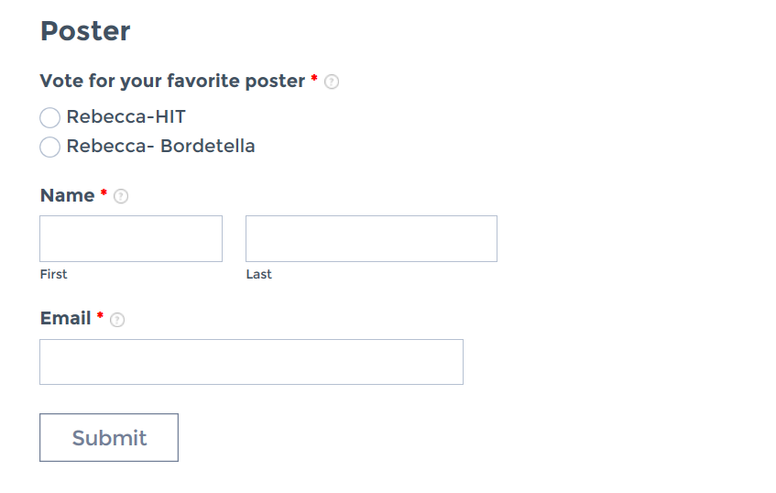

Slide 65
Winner will be announced March 25th !
Prizes
A certificate from ASCLS region V will be offered to the winner of the poster presentation
The winner will be featured in the ASCLS Leadership Academy Blog
The winner will receive a free registration to the 2017 ASCLS Region V meeting.

Slide 66
Advantages and Disadvantages of the virtual poster competition
Larger amount of participants
Can reach a larger audience
Programs have different timelines
Technical limitations

Slide 67
Improvements for next year
Perhaps part of the competition can take place during the ASCLS region V symposium
Voting during the symposium

Slide 68
Will you spread the word?
MLS/MLT program directors please inform students of this opportunity
This is open to anyone in the laboratory field so spread the word!
Contact Rebecca with any questions or comments
701-893-5076
Rebecca2ram@gmail.com

Slide 69
sustainability
How do we maintain this project for years to come?

Slide 70
Blog Author
Position Summary

Slide 71
Term
Indefinite; until individual resigns post, fails to fulfill the responsibilities of the position, or qualifications are no longer met, as determined by the Region V Director.
Responsible To
Region V Director
Eligibility
Current ASCLS membership, all membership levels eligible
Member of one the Region V state societies: MN, ND, SD, or WI
Application
By nomination, either self-nomination or peer nomination to the nominations committee. No formal application required.

Slide 72
Duties and Responsibilities
Each Blog Author is required to:
Post a minimum of one post per week to blog.
Publish posts with appropriate content, including:
Laboratory science, healthcare, or professional development related topics
ASCLS-related activities, such as sponsored events, government affairs, or continuing education opportunities
Abide by the bylaws set forth by ASCLS regarding proper use of social media sites.
Refer to “Social Media Policy.” American Society for Clinical Laboratory Science.

Slide 73
Estimated COSTS
BLOG
NO COST
MINI PROJECTS
BROCHURES
NO COST
ELEVATOR SPEECHES
MATERIALS FOR PRESENTATIONS
POSTER PROJECT
PRIZE

Slide 74
QUESTIONS?
SUGGESTIONS?

Slide 75
Thank you

